Slide 1
The Physical Layer

Slide 2
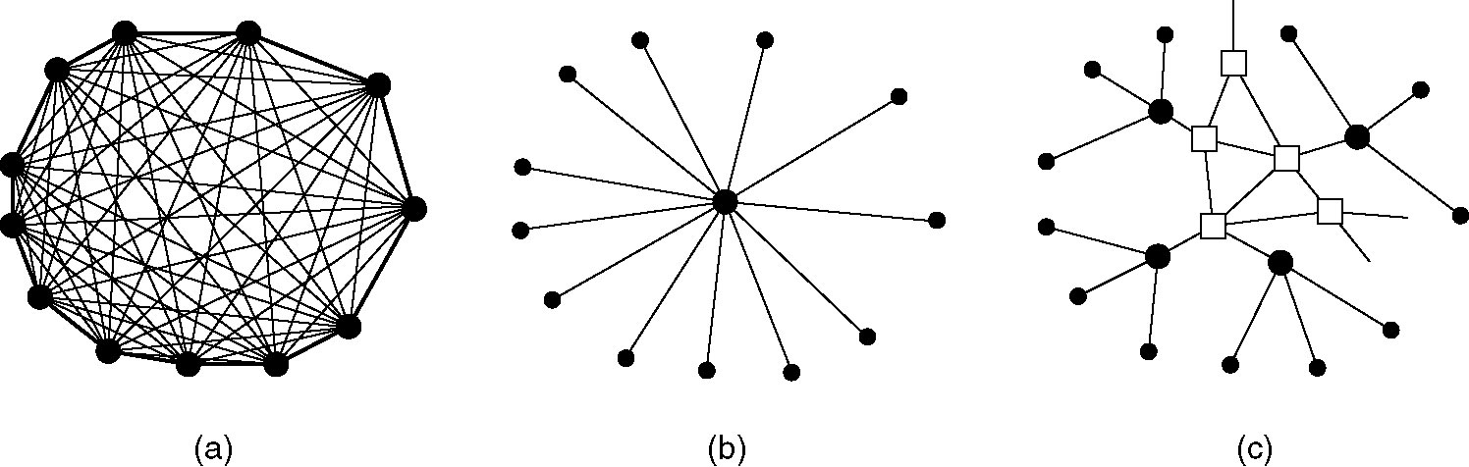
Structure of the Telephone System
(a) Fully-interconnected network.
(b) Centralized switch.
(c) Two-level hierarchy.
Notes:
Mesh fashion
problem: extremely expensive & impractical
Only feasible for small networks
b. All phones connected to one central switch, when A calls B, the switch connects them temporarily
c. Introduces hierarchy leve
local switches connecting to high-level switches
Foundation of modern telephones

Slide 3
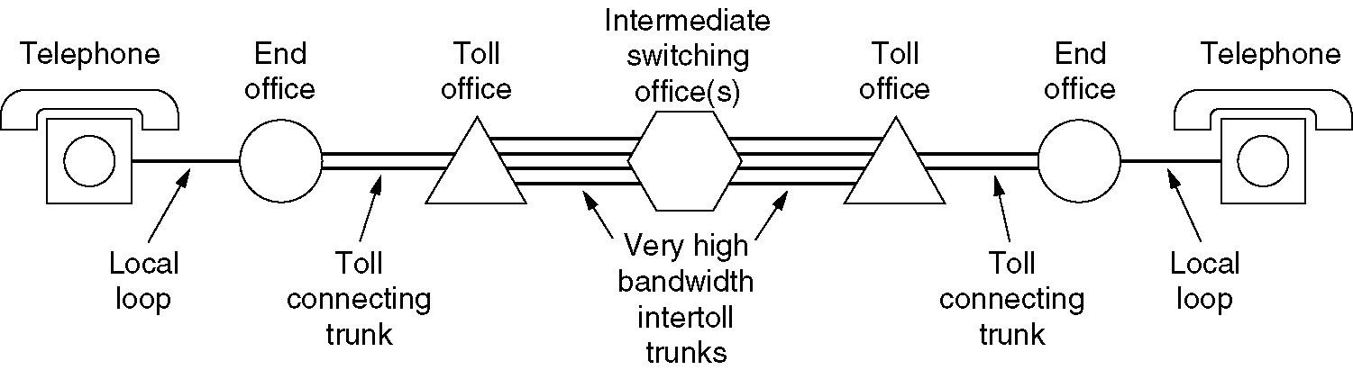
Structure of the Telephone System (2)
A typical circuit route for a medium-distance call.
Notes:
-caller A and B are not in the same network
Local exchange (nearest switching office)
End office connects to the toll switch (high-level switch)
Toll switch route the calls using trunks to another toll switch closer to destination

Slide 4
Major Components of the Telephone System
Local loops
  Analog twisted pairs going to houses and businesses
Trunks
  Digital fiber optics connecting the switching offices
Switching offices
  Where calls are moved from one trunk to another
Notes:
Switching office is also called the brain of the system

Slide 5
Multiplexing
Multiplexing is a method by which multiple analog or digital signals are combined into one signal over a shared medium.
The aim is to share a scarce resource.
For example, in telecommunications, several telephone calls may be carried using one wire
Single trunk(fiber) can carry thousands of simultaneous phone calls
Without multiplexing, each call would need its own physical wire

Slide 6
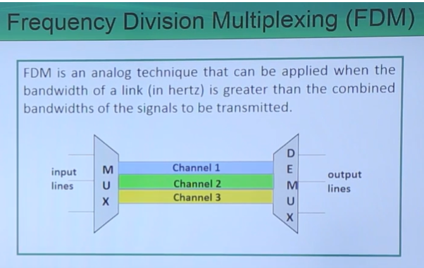
Notes:
-technique where available of CC divided into smaller frequency bands
Each band carries separate signal ( channel 1 carry one call)
Each signal is modulated (shifted) to a higher frequency band so they don’t overlap
All shifted signals combined into one wide channel & sent together over the truck
At the receiving end, signals are demux using filters

Slide 7
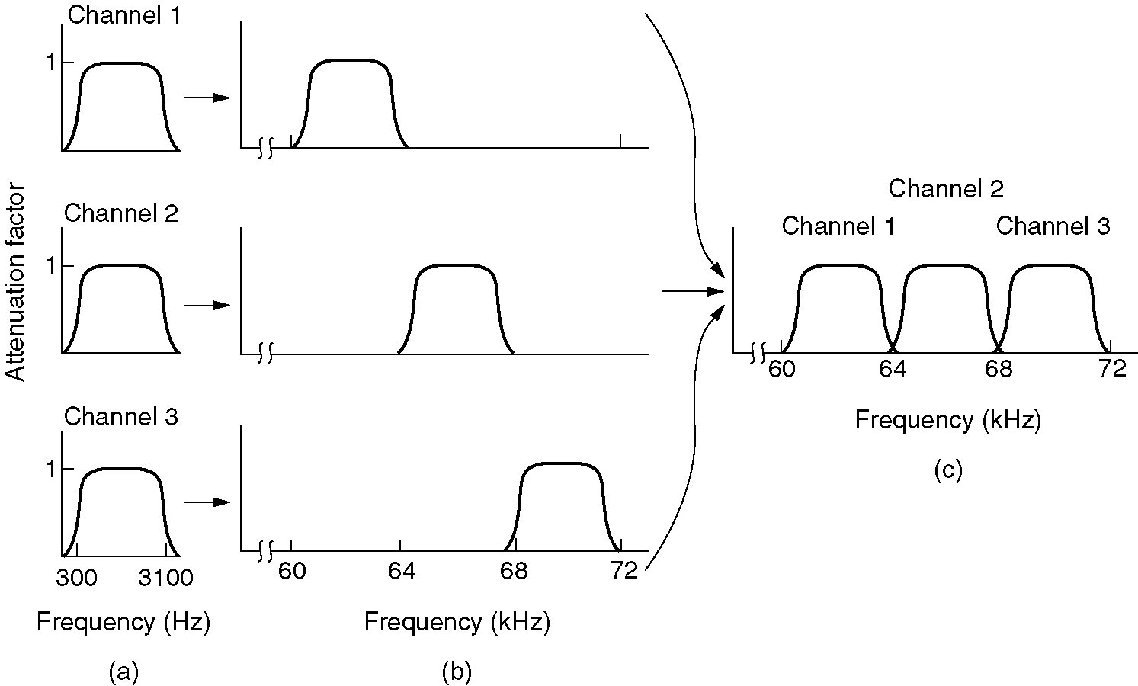
Frequency Division Multiplexing
(a) The original bandwidths.
(b) The bandwidths raised in frequency.
(b) The multiplexed channel.
Notes:
FDM works on copper/coaxial cables

Slide 8
Wavelength division multiplexing
Optical version of FDM, used in fiber optic cables
Rather than dividing the signal by electrical frequency
WDM divides the light by various wavelengths (colors) of laser light.
Modern WDM systems carry hundreds of channels on a single fiber
Each channel can run at very high speeds (10Gbps or more)
It have enormous capacity, one fiber can carry terabits of data per second

Slide 9
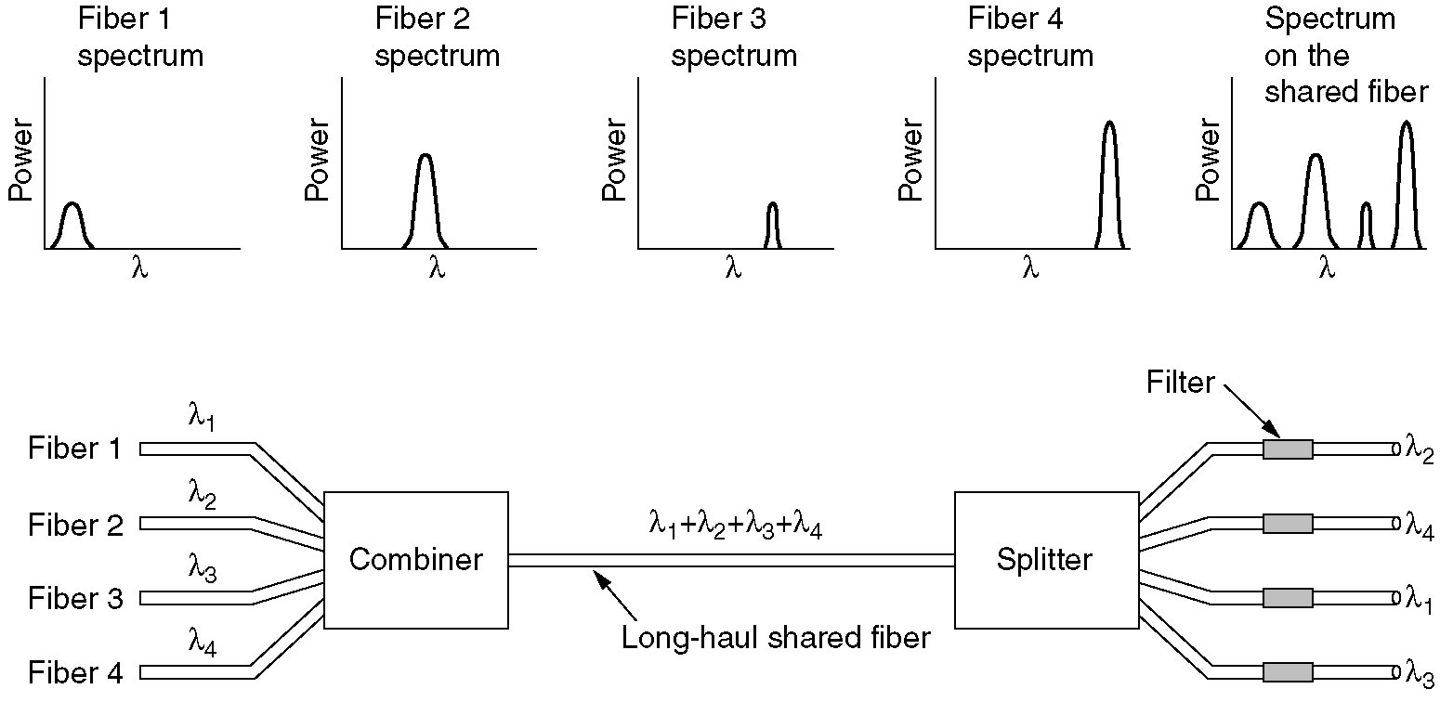
Wavelength Division Multiplexing
Wavelength division multiplexing.
Notes:
A single fiber carries many different wavelengths of light at the same time
Each wavelength carries its own independent data stream (call, internet, video )
At the receiving end, special filters separate the wavelengths

Slide 10
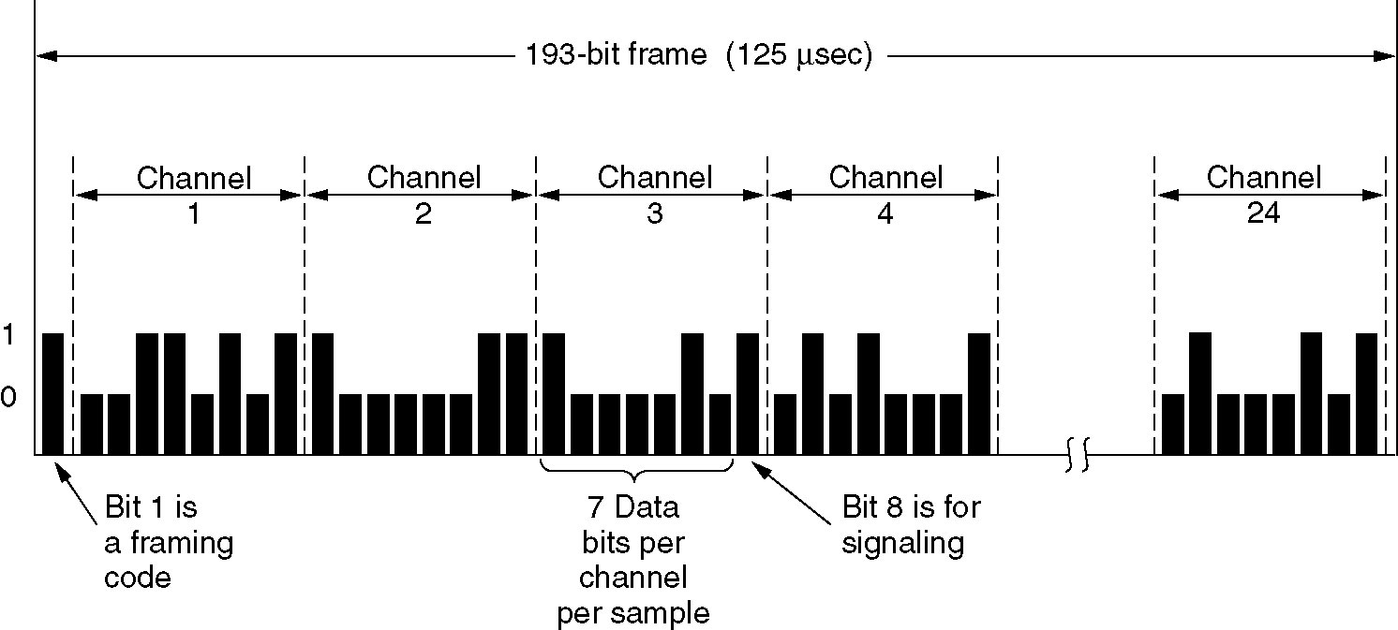
Time Division Multiplexing
The T1 carrier (1.544 Mbps).
Notes:
Divide time into small slots, not frequency or wavelength
Channel has a high transmission rate

Slide 11
TMD
Digital multiplexing technique where multiple signals share the same channel by taking turns in time.
  The channel has a high transmission rate
  Time is divided into fixed-length slots
  Each input signal (phone call) given 1 or more- slots in a repeating cycle
  At R, slots are demultiplexed back to individual signals

Slide 12
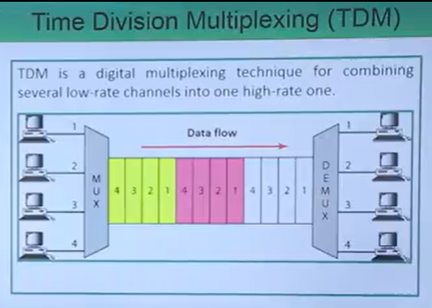
Notes:
Do check the advantages and disadvantages for TDM

Slide 13
Example
Imagine a company with 4 employees who need to make phone calls to customers, but there is only one Comm line available.
Instead of giving each employee a separate line, the telephone system uses TDM
  Comm line is divided into very small time slots
  Each employee is assigned a specific time slot
  During Employee A’s time slot, only their voice is transmitted
  Same for all other employees
  The cycle repeats thousands of times every second, making it seem as though everyone is talking continuously.

Slide 14
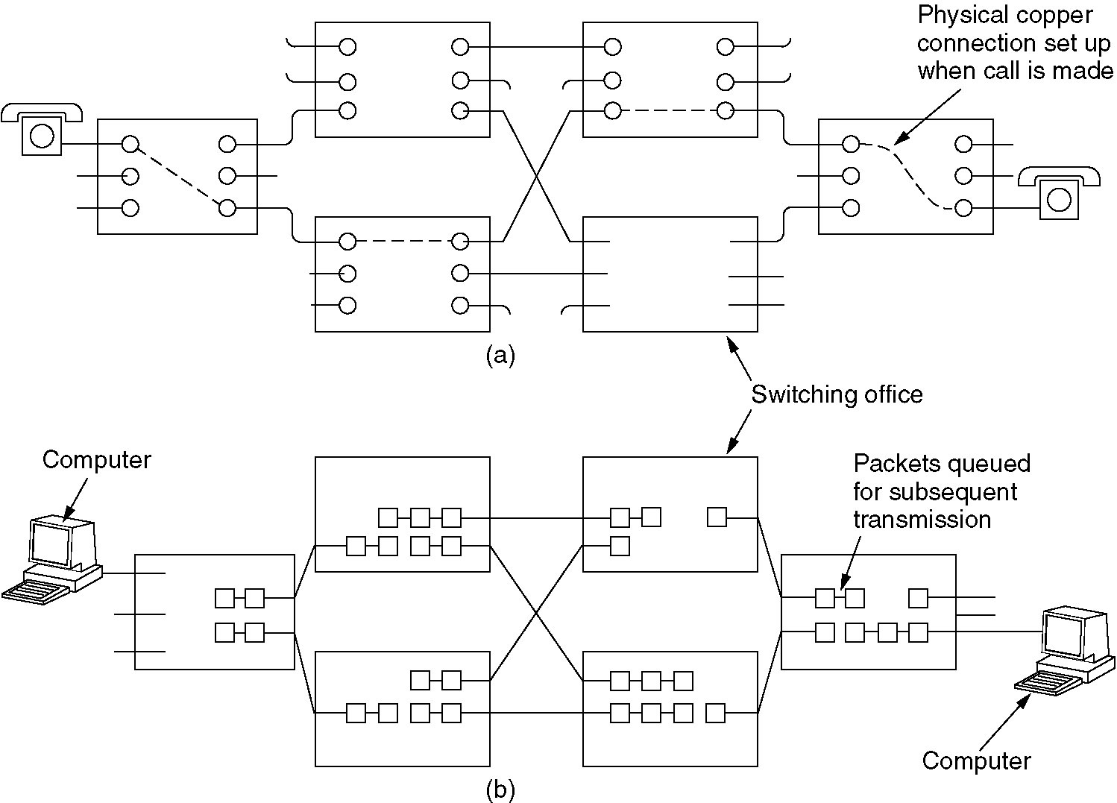
Circuit Switching
(a) Circuit switching.
(b) Packet switching.
Notes:
Selecting a path that data must take out of the available options is called switching.

Slide 15
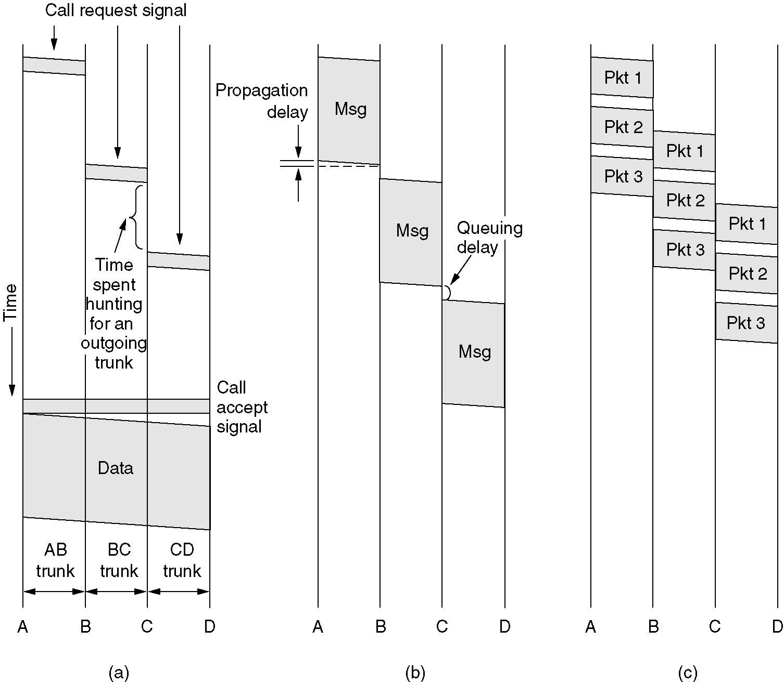
Switching techniques
(a) Circuit switching (b) Message switching (c) Packet switching
Notes:
Fundamental switching techniques in networking

Slide 16
Circuit switching
A switching technique where a dedicated physical path (circuit) is established between the S & R before any data is sent.
Once connection is set up, the entire path is reserved exclusively for that comm until session ends.
  Connection establishment phase
    S requests a connection to the R
    Network finds & reserves a path
    R accepts→ connection established

Slide 17
Circuit switching
Data transfer phase
  Data flows continuously over the dedicated path
  No routing decisions needed during transmission
  Connection termination phase
    When finished, the path is released
    Key characteristics
    Dedicated path – fixed & guaranteed during call
    No sharing – the path cannot be used by others until released
    Predictable delay – good for real-time voice

Slide 18
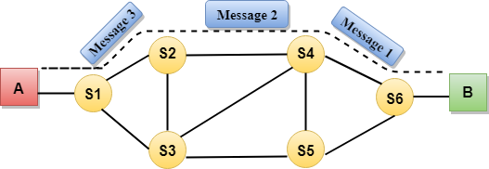
Circuit switching

Slide 19
Drawbacks of circuit switching
S & D must be available at the time of data transfer.
Once the dedicated path is established, the only delay occurs in the speed of data transmission.
It takes a long time to establish a connection approx. 10 seconds during which no data can be transmitted.

Slide 20
Drawbacks of circuit switching
It is more expensive than other switching techniques, as a dedicated path is required for each connection.
It is inefficient to use because once the path is established and no data is transferred, then the capacity of the path is wasted.
In this case, the connection is dedicated; therefore, no other data can be transferred even if the channel is free

Slide 21
Message switching
The entire message is treated as a single unit. Sent from node to node,
Stored completely at each intermediate node
Forwarded to the next node
No dedicated end-to-end path like in circuit
  How it works
    S sends complete message to D address
    Message travels hop by hop
    Each intermediate node
      Receives & stores the entire message
      Check errors
      Looks for best route & forwards it to the next node when outgoing link is free until message reaches destination

Slide 22
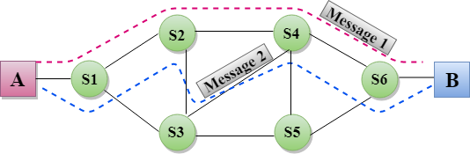
Message switching

Slide 23
Message Switching
Nodes are equipped with enough buffers to hold the incoming message.
If a station wishes to send a message to another station, it first adds the D address to the message.
The intermediate node stores the complete message temporarily, inspects it for errors, and transmits the message to the next node based on an available free channel and its routing information.

Slide 24
Advantages of Message Switching
Efficient use of channels
No need for simultaneous availability
Mutli-destination support
Various speeds supported (S &D can have differ data rates)
Better reliability – messages can be stored & re-routed if a link or node fails

Slide 25
Disadvantages of Message Switching
It is not suitable for real-time or interactive traffic. It is not suitable for voice transmission.
As message length is unlimited, each switching node must have sufficient storage to buffer messages.
Storing & forwarding facility introduces delay, making message switching unsuitable for real-time applications like voice and video.

Slide 26
Packet switching
The packet switching is a switching technique in which the message is sent in one go, but it is divided into smaller pieces, and they are sent individually.
The message splits into smaller pieces known as packets and packets are given a unique number to identify their order at the receiving end.
Every packet contains some information in its headers such as source address, destination address and sequence number.

Slide 27
Packet switching
A technique where a message is broken into smaller pieces called packets
How it works:
  Original message divided into smaller packets
  Each packet (S & D address, sequence number)
  Packets travel independently through the network
    Can take different routes
    They are stored & forwarded at each router

Slide 28
At the D, packets are reassembled
If any packet (lost or corrupted) , it is retransmitted
  Highly efficient use of bandwidth
  Robust – can handle failures by rerouting packets
  Good for bursty traffic (internet data)
  Supports multiple users sharing same link simultaneously

Slide 29
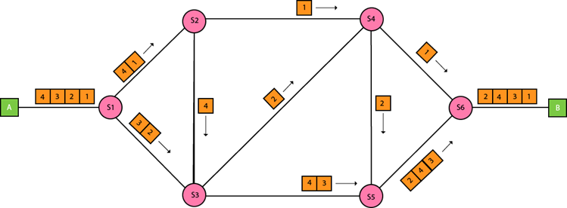
Packet switching

